Slide 1


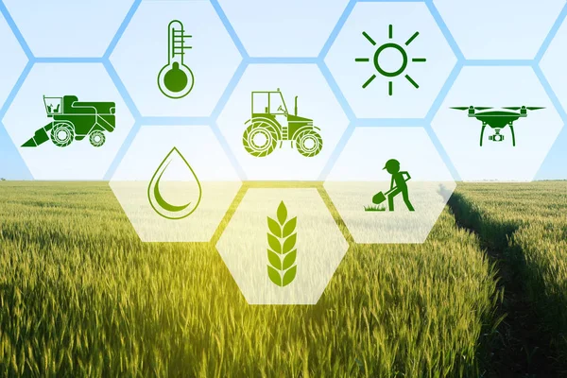
Cooling Fields, Nurturing Yields
Shivam Ranjan - 2301157
Siddharth Panigrahi - 2301161
Sumit Singhal - 2301171
Shreeyanka Rout 2302232
Soumya Shrivastava - 2302243
Souvik Dey - 2302247
Subham Agrawal - 2302251

Slide 2

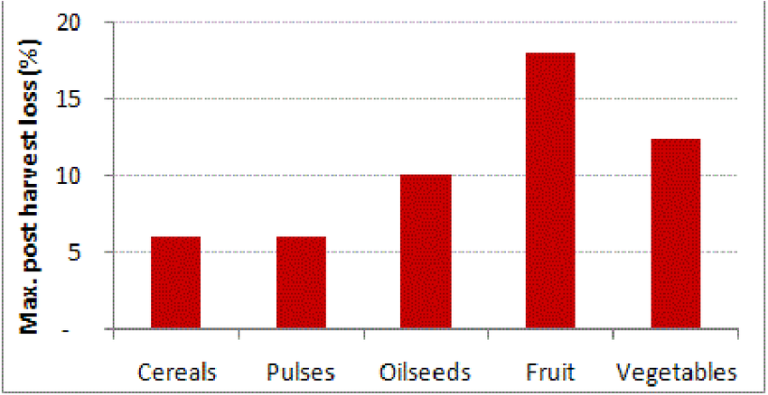
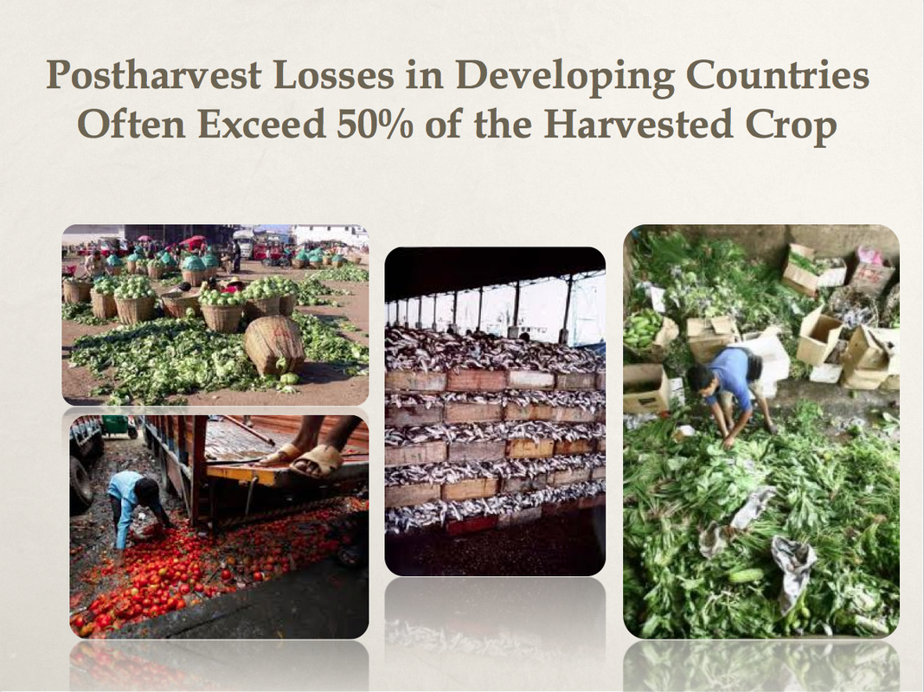
India's bountiful agriculture suffers from massive post-harvest losses (30%), volatile crop prices, and limited market access for farmers, due to inadequate storage and traditional middlemen.
Problem Statement
Estimated Wastage
16-40%
Annual Wastage
50,000 Crores
Most Wasted Category
Fruits and Vegetables
(4.58-15.88%)
Quantity of Food Wasted
1.3 Billion Tons

Slide 3
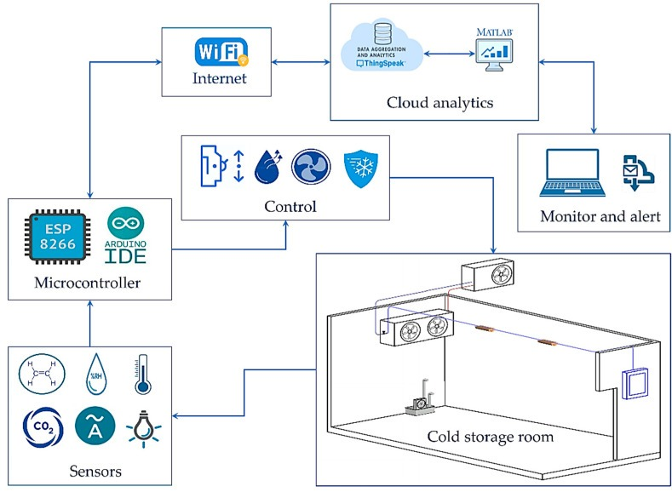
Solution Architecture

Slide 4
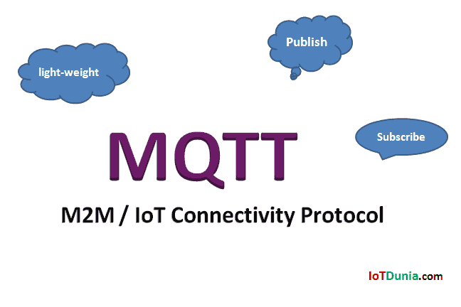
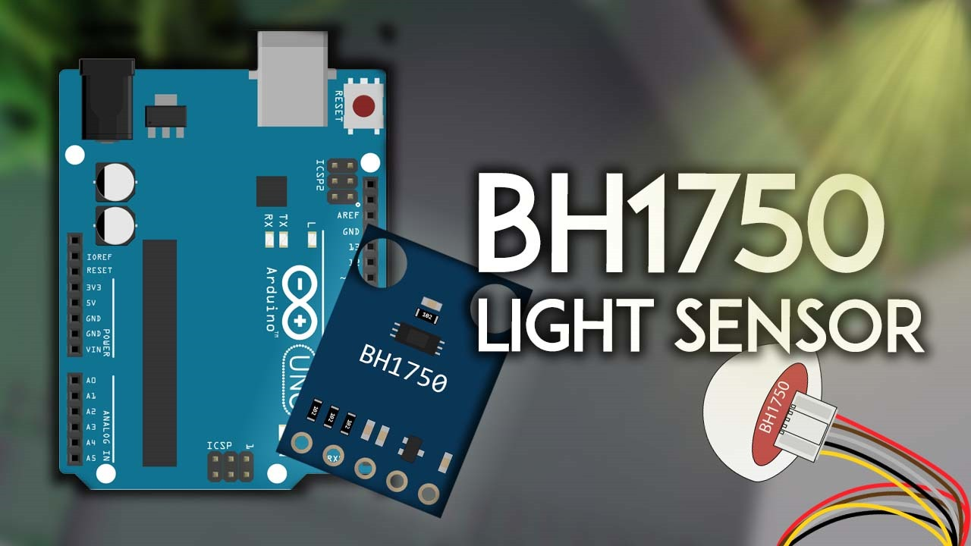
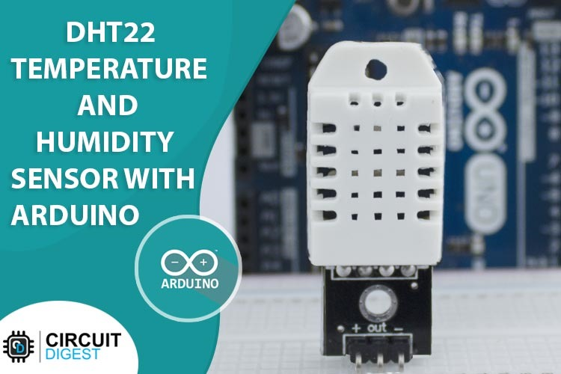
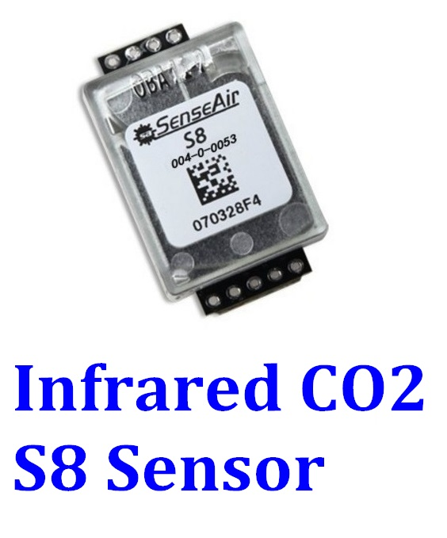

Protocol and Sensors Employed
MQTT
Light Sensor
Temperature & Humidity sensor
Infrared ${CO}_{2}$ Sensor
MQTT is a lightweight messaging protocol used in IoT for efficient device communication. It operates on a publish/subscribe model and ensures reliable message delivery with minimal overhead.
The BH1750 is a digital light sensor used for measuring ambient light levels. It's often employed in applications like smart lighting control and automatic brightness adjustment for displays.
The DHT22 sensor is a digital temperature and humidity sensor known for its accuracy and ease of use. It provides precise temperature readings from -40°C to 80°C and humidity readings from 0% to 100%. With a simple interface, it's widely used in projects requiring environmental monitoring.
The Infrared CO2 S8 sensor is a small yet powerful tool for measuring carbon dioxide levels in the air. It uses infrared light absorption to detect CO2 concentrations accurately, making it ideal for environmental monitoring and indoor air quality assessment in IoT projects.

Slide 5


Scalability, Benefits and Transformation
01
02
03
Scalability and Adaptability with Solar Energy
Benefits of Advanced Agricultural Solutions
Driving Transformation in Agriculture:
By leveraging solar energy and innovative technologies, we stimulate economic growth and catalyze a shift towards sustainable agricultural practices.
Utilizing solar energy ensures our product's scalability and adaptability, enabling deployment across diverse regions and crops.
Solar-powered solutions significantly reduce post-harvest losses, stabilize prices, and enhance food security and market access.

Slide 6
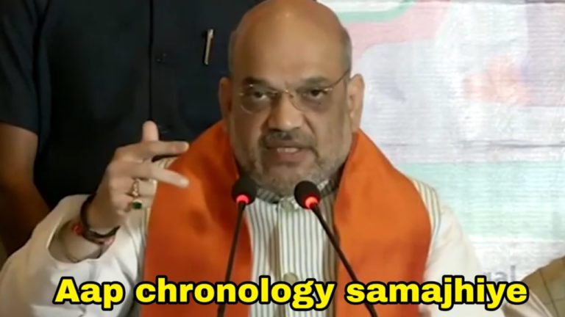
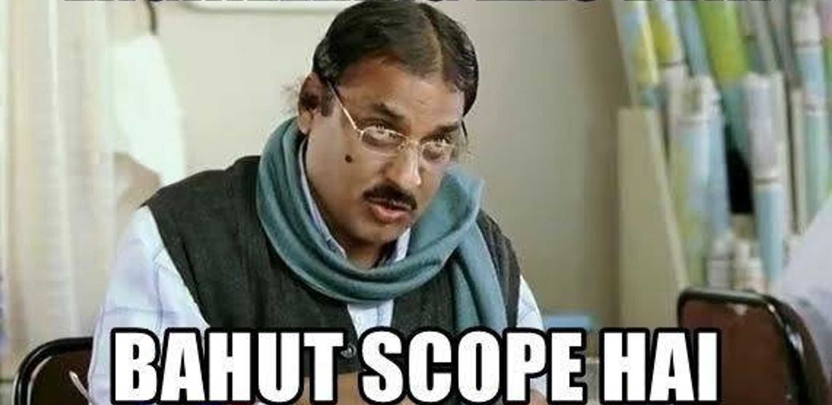
Future Scope : Building Resilient Crop Ecosystems
Utilize computer vision algorithms to analyze visual characteristics and detect signs of spoilage or deterioration, enabling timely intervention and optimization of storage parameters.
01
Implement sensors and IoT devices to track inventory movement and trigger alerts for replenishment or distribution, ensuring efficient stock management and minimizing wastage.
02
Provide training and resources to enable farmers to diagnose and resolve common problems independently, fostering a culture of self-reliance and collaboration.
03
Integrate data from various sources, including weather forecasts, soil sensors, and satellite imagery, to provide actionable insights and personalized recommendations for optimized crop management practices.
04

Slide 7



